Slide 1

Welcome to 2022-2023 Registration ☺
Today we are going to talk about:
Academic Planning
7th Grade Registration

Slide 2
Looking Ahead to High School
You will need 26 credits to graduate from high school with the foundation plan and an endorsement
You can earn some high school credits in middle school.

Slide 3
Foundation with Endorsements
English – English I, English II, English III + 4th English Credit | 4 Credits
Math – Algebra I, Geometry + 2 Advanced Maths (Alg 2 required for some) | 4 Credits
Science – Biology + IPC/Chem/Physics + 2 Advanced Sciences | 4 Credits
Social Studies – W.Geog/W.Hist + US History + Govt & Eco | 3 Credits
Health | ½ Credit
PACE – 9th Grade Year | ½ Credit
PE | 1 Credit
Language Other Than English – LOTE 1 + LOTE 2/Alternate* | 2 Credits
Fine Arts | 1 Credit
Electives | 6 Credits
TOTAL STATE CREDITS | 26

Slide 4
Endorsements
STEM | Arts & Humanities
Engineer | Journalist
Computer Programmer | Editor
Geoscientist | Musician
Pharmacist | Art Director
Statistician | Graphic Designer
Chemist | Multimedia Artist & Director
Many more… | Many more…

Slide 5
Endorsements
Public Service | Business and Industry
Teacher | Financial Planner
Social Worker | Accountant
Police Officer | Agricultural Business
Military | Architecture
Nurse | Industrial Manager
Dental Hygienist | Internet Security Analyst
EMT | Chef
Diagnostic Medical Sonographer | Welder
Multidisciplinary
4x4
AP or Dual Credit

Slide 6
6th to 7th Grade Registration
What classes do I take next year?
Required
Electives

Slide 7


REQUIRED COURSES
Language Arts
Math
Science
Texas History
P.E. or Athletics
Elective/Reading
Elective/Reading/Math Lab
K- level VS On-level
Courses

Slide 8
Reading Class/Math Lab
Placement in reading class or math lab will depend on Reading & Math STAAR performance and/or your final grade in language arts and math.
Do your best!! ☺

Slide 9
Physical Education
FULL YEAR - Regular P.E.
Athletics Girls
  Cross Country, Volleyball, Basketball, Track
Athletics Boys
  Cross Country, Football, Basketball, Track
Athletics---MUST have a doctor’s physical and it is a FULL YEAR course

Slide 10
Full Year Electives
The following classes are FULL YEAR COMMITMENTS.
If you sign up, you will be in this class ALL year. There will not be changes made during the year.

Slide 11

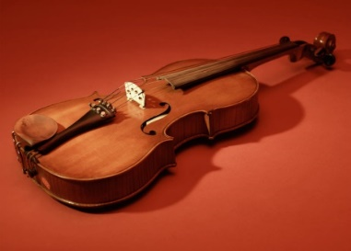

Band/Orchestra
If you have never taken band before, you will be in Beginning Band with mostly 6th graders.
Instruments are not provided – you must purchase or rent your instrument.
Teacher Approval: If continuing in band or orchestra – you will have an audition and may be placed in the appropriate class.
Fees:
  Band Instrument plus $10
  Orchestra Instrument plus $30

Slide 12

Beginning Art
For 7th or 8th grade.
This course includes the fundamentals of design, drawing, painting, and sculpture. Students will learn about art materials, concepts, and vocabulary.
Fees: $5 - $12

Slide 13

Advanced Art
For 7th and 8th grade.
It offers an in-depth study of concepts directly related to the elements of art and principles of design.
Prerequisite: Previous Art Course (ART 6) and Teacher Approval
Fees: $5 - $12

Slide 14



Choir
Full year choir elective.
Learn about the voice, how to read music, and how to sing in a choir setting.
Choir director will decide on which choir will you be in.
Fees: $30

Slide 15
Beginning Theatre Arts
For 7th and 8th grade.
Acting/Theater based course. Emphasis will be placed on a variety of in class performances and individual/group presentations.
Must attend tournaments
Fees: $20 plus tournament fees

Slide 16

Intermediate Theatre Arts
For 7th and 8th grade.
Prerequisite: Theater Arts 6 OR Rotation
Acting/Theater based course. Emphasis will be placed on a variety of in class performances and individual/group presentations.
Must participate in tournaments.
Fees: $20 plus tournament fees

Slide 17


Principles of Human Services
1 HS Credit
For 7th and 8th grade.
This course will enable students to investigate careers in the Human Services Career Cluster, including counseling and mental health, early childhood development, family and community, personal care and consumer services.
Fees: $20

Slide 18

Foreign Language = High School Credits
You need two years of the same foreign language to graduate.
You may choose to begin your foreign language in middle school and earn high school credit.

Slide 19


Full Year Electives - Foreign Languages
1 HS credit
Spanish I
  Prerequisite: Second semester average of 80+ in on-level 6th grade LA or 75+ in Level 1 or Horizons LA.
Spanish Native Speaker I
  Spanish language background – must be able to read, write, and speak Spanish.
  Placement test.

Slide 20

Principles of Applied Engineering (Tech) 1 HS Credit
For 7th and 8th graders.
Students will develop engineering communication skills, which include computer graphics, modeling, and presentations, by using a variety of computer hardware and software applications to complete assignments and projects.
Project fees: $85 year/$42.50 per semester
No prerequisite

Slide 21

Yearbook
For 7th and 8th grade.
In this entry-level publications class, students will become adept in their understanding and use of media, technology, and publishing software.
Must fill out an application and get accepted.
See Ms. Suppo

Slide 22

Intermediate Speech
For 7th and 8th grade.
½ high school credit
75+ average in language arts/reading during the previous year
The is class will help students build overall confidence in public speaking for different occasions
This Photo by Unknown Author is licensed under CC BY-NC

Slide 23
Semester Electives
The following classes are only 1 semester.
You must choose 2 semester courses to make 1 year.

Slide 24


Semester Electives
Art Design
  For 7th and 8th grade.
  General Art – draw, paint and sculpt.
  Fees: $10
Exploring Foods and Fabrics
  2 part hands-on course – cooking and sewing
  Fees: $10

Slide 25


Semester Electives
Touch System Data Entry
  Keyboarding
  ½ high school credit
  Professional Communications
    Prepare and present presentations to a group.
    ½ high school credit

Slide 26


Semester Electives
LeadWorthy
  For 7th & 8th graders
  This course will help students develop an understanding of what it means to be an 21st century leader and an effective member of the community
Coding & Robotics
  For 7th & 8th Graders
  Introduction into computer science, coding, and robotics

Slide 27

      How to complete your registration sheet:
Select your PE (athletics or PE)
Choose your alternate electives with care … it may become your class for next year!
Parent signature
Return to your World Cultures teacher by Friday, February 4th.
If you do not turn in your registration sheet, then your electives will be chosen for you.

Slide 28
Write down the names of your elective choices & the course #s
FALL SEMESTER | SPRING SEMESTER
Language Arts | Language Arts
Math | Math
Science | Science
U.S. History | U.S. History
1st Elective (Course name) (Course number) 2nd Elective (Course name) (Course number) | 1st Elective (Course name) (Course number) 2nd Elective (Course name) (Course number)

Slide 29
*Make sure to include Alternate Elective Choices in case you do not get your 1st or 2nd choice*

Slide 30
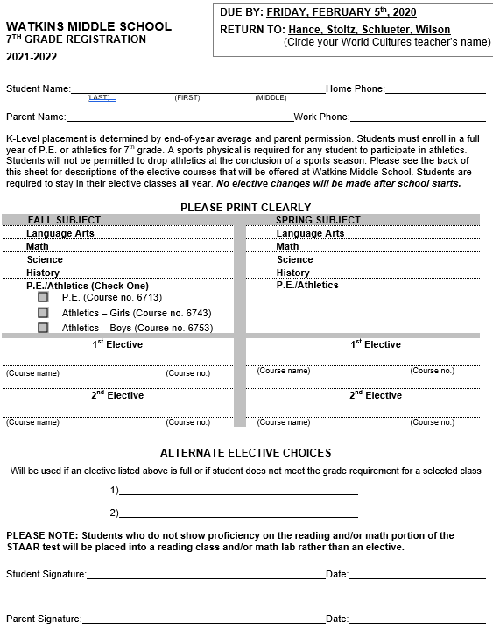





Due By: Friday February 4th, 2022
Return to Hance, M. Perez, Schlueter, Wilson
(Circle your world culture teacher’s name)

Slide 31

Some things to think about…
If you select a full-year elective or Athletics you are required to stay in that class ALL year
If you sign up for ATHLETICS, you MUST participate in a sport, and remain in the class ALL year

Slide 32
WOW!
You’re almost a 7th grader!
Turn in your registration sheet to your World Cultures Teacher by Friday, February 4th.

