Slide 1
Stress & Anxiety
in High School
DONNA DUNN, M.ED.
Former CFISD Coordinator for
High School Guidance & Counseling

Slide 2
Donna Dunn, M.Ed.
Education:
BA English/Education – UT Arlington
M.Ed. in Counseling– University of North Texas
Experience:
Former CFISD Coordinator of High School Guidance & Counseling
29 years counseling experience (12 years - elementary & 17 years - high school)
8 years teaching experience

Slide 3
The Teen Brain:
Important Things to Know
During adolescence, the brain goes through rapid changes in its shape and size and also in how it works.
The brain reaches its biggest size in early adolescence and continues to develop and mature until the mid-20s.
The structures and connections in the brain that help to manage emotions are in flux during adolescence, making teens especially vulnerable to stress and anxiety.
Teens need more sleep than children and adults.
Research has shown that melatonin (the “sleep” hormone) levels in the blood are naturally higher later at night and drop later in the morning in teens than in children and adults.
Teens should get about 9 to 10 hours of sleep a night. Lack of sleep can make it hard to pay attention, increase impulsivity, and may increase the risk of irritability or depression.
The teen brain is resilient. Although adolescence is a vulnerable time for the brain and for teenagers in general, most teens go on to become healthy adults.
*Information source: National Institute of Mental Health

Slide 4
How Prevalent is
Anxiety Among Teens?
Anxiety disorders are the most common mental health disorder in the United States.
Different resources provide different statistics regarding the percentage of adolescents affected by anxiety.
Johns Hopkins All Children’s Hospital: 1 in 10 to 1 in 13 people suffer from anxiety, with about 8% of children and teenagers experiencing an anxiety disorder.
ADAA (Anxiety and Depression Association of America): Anxiety disorders affect 31.9% of adolescents between 13 and 18 years old.
NIMH found that 19 percent of all US adults have suffered from an anxiety disorder in the last year, as opposed to nearly 32 percent of teens. In addition, teen girls suffer from anxiety disorders more than any other group.
The number of teens experiencing an anxiety disorder grew during the COVID-19 pandemic.
*Information sources: Johns Hopkins All Children’s Hospital/J. Katzenstein, Ph.D,
ADAA – Anxiety and Depression Association of America, National Institute of Mental Health

Slide 5
What Causes Anxiety?
The causes of anxiety disorders aren't fully understood.
Life experiences such as traumatic events appear to trigger anxiety disorders in people who are already prone to anxiety.
Inherited traits also can be a factor.
For some people, anxiety may be linked to an underlying health issue.
In some cases, anxiety signs and symptoms are the first indicators of a medical illness.
Sometimes anxiety can be a side effect of certain medications.
*Information source: Mayo Clinic

Slide 6
Stress vs. Anxiety
STRESS
ANXIETY
Response to external cause (big test, fight with friend)
Resolution of issue causes stress to go away.
Stress can be good or bad. It can give a person the momentum to meet a deadline or it may cause loss of sleep.
Response is internal (personal reaction to stress).
Persistent feeling of apprehension or dread that won’t go away and interferes with how a person lives his/her life.
It’s constant, even if there is no immediate threat.
*Information source: National Institute of Mental Health

Slide 7
COMMONALITIES OF
Stress and Anxiety
Both can affect a person’s mind and body causing symptoms such as:
Excessive worry
Uneasiness
Tension
Headaches or body pain
High blood pressure
Loss of sleep
*Information source: National Institute of Mental Health

Slide 8
Times That Can Result in Anxiety
and Stress for Teens
During the teen years, a time when teenagers brains are changing, and they want more autonomy and independence, there are many stressors such as:
Starting High School
Looking a particular way
Fitting in with friends
Final examinations/schoolwork
Performing in plays, etc. at school
Going to dances and school formals
Now more than ever, teenagers have even more worries with political
affairs, effects from the pandemic, and social media.
*Information source: Johns Hopkins All Children’s Hospital/J. Katzenstein, Ph.D

Slide 9
Moving Up To 9th Grade
Can Be Exciting and Stressful
Because 3 to 4 middle schools feed into one high school, the total number of students in a freshmen class is typically two to three times larger than the 8th grade class from the sending school.
Some of the concerns/worries/fears that might cause students to experience stress and anxiety when entering high school include:
Getting lost (They’ve moved from a “village” to a “city” going from MS to HS.)
Not having middle school friends in their classes
The group of friend(s) from MS now have different lunch times.
Trying out for sports teams/drill team/cheerleading, etc. and worried about making the team.
Being picked on by older students; singled out due to differences.
Realization that the grades they make at the end of their first semester of 9th grade will be calculated and become the starting point of their high school GPA.

Slide 10
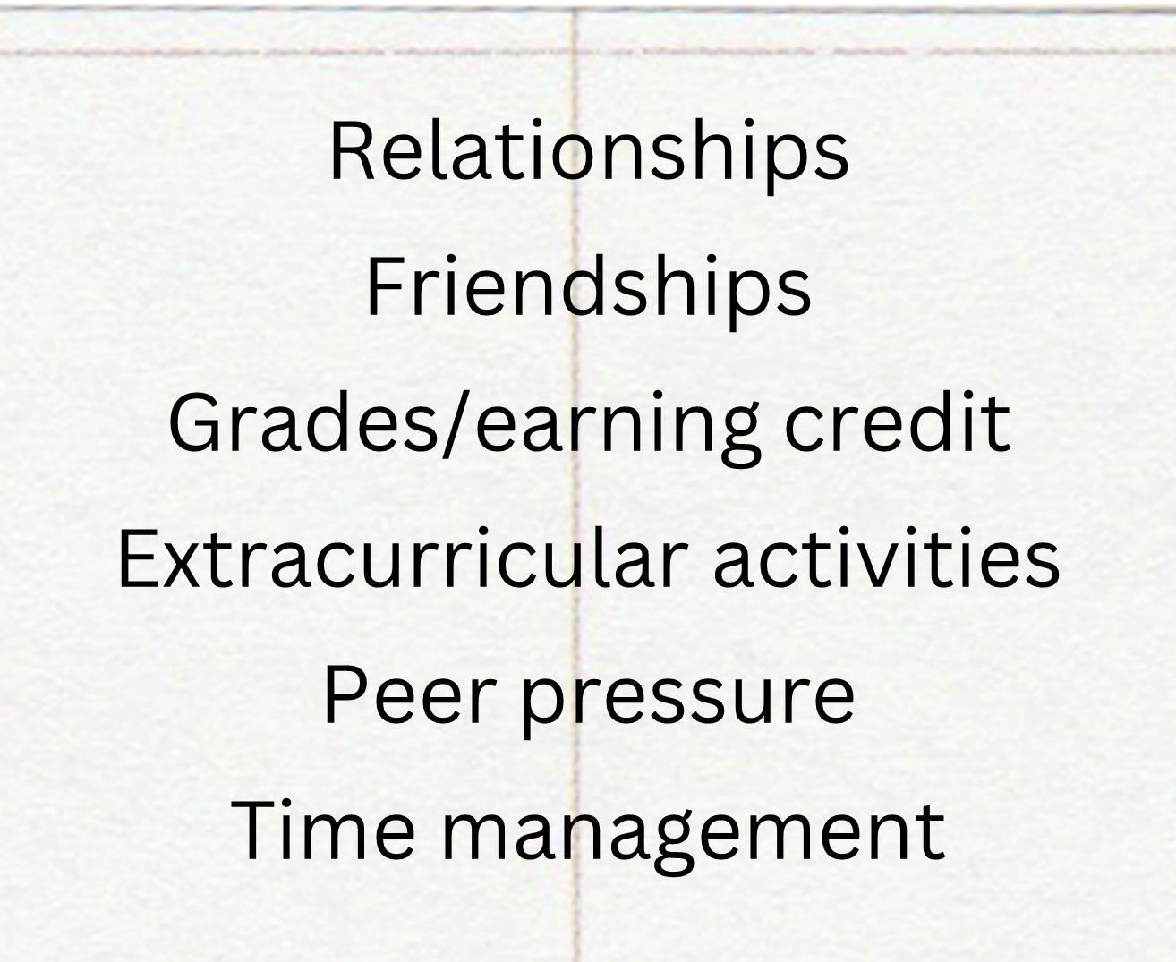
Survey of Cy-Ranch Counselors
Sophomores (10th)
rigor of classes
choosing the right courses for endorsement/ academic path to follow over the next two years.
ALL GRADES:
Seniors (12th)
college applications
“Senoritis”
unknown future, leaving home
balancing work/school/ home expectations.
Juniors (11th)
class rank/GPA for college applications
preparing to apply to college
balancing school/work/ home expectations.

Slide 11
Performance Anxiety
Performance Anxiety is a feeling someone might have in a situation where performance is very important or there is a lot of pressure to do well, such as:
Test Anxiety (high school subject tests/state testing /SAT/ACT)
Trying out for a school play
Singing a solo
Pitching in the big game
Submitting applications to college
Test Anxiety Strategies
Focus on strong study strategies without distraction
Envision success
Get a good night’s sleep before the exam
Practice coping strategies such as:
calming breathing
Self-calming via progressive muscle relaxation
positive thoughts
*Information Source: Johns Hopkins All Children’s Hospital/J. Katzenstein, Ph.D.

Slide 12
Forms of Anxiety
Anxiety can take many difference forms.
Some are more physical, some are more
related to mental worry, and some
only present in specific situations.
Social Anxiety
Fear of being negatively judged or rejected by other people.
Worry about acting “stupid” or boring.
Fears and worry can cause avoidance of social interactions.
Generalized Anxiety Disorder
Worrying excessively about everyday things like home, school, or friends.
These worries are difficult to control.
Panic Attacks
Panic Attacks are the physical manifestation of anxiety.
Physical symptoms of panic attacks include: headaches, feeling like you’re outside of yourself looking in, dizziness, stomachaches, nausea, rapid breathing, quick heart rate; tense muscles, sweating, and shakiness.
Panic Attacks always have a trigger, but can feel totally random.
A panic attack is not a heart attack and it won’t make a person suffocate.
*Information source: Anxiety Relief for Teens/Regine Galanti, PhD.

Slide 13
Forms of Anxiety Continued
Phobias
Intense fears of specific situations, often to the point of being irrational because the fear doesn’t match the reality of the threat.
Phobias typically focus on animals, insects, germs, extreme weather, or enclosed spaces.
Separation Anxiety
Fear of being away from people to whom the person feels close, typically his/her parents.
Imagine the worst will happen when apart.
Obsessive-Compulsive Disorder
Involves thoughts that stick in the person’s head and causes distress. Thoughts become obsessive which causes a behavior (a compulsion).
The compulsive behavior makes the person feel better for the short term, but can lead to more obsessions that only make him/her more anxious and produces more compulsions.
*Information source: Anxiety Relief for Teens/Regine Galanti, PhD.

Slide 14
Worries
Irritable/nervous
Restless
Wound-up
On edge
Easily fatigued
Difficulty concentrating
Mind going blank
Sleep problems
Muscle tension
Headaches
Stomachaches and pain
Signs & Symptoms
of Anxiety
in Teens
*Information source: Johns Hopkins All Children’s Hospital/J. Katzenstein, Ph.D.

Slide 15
Strategies for Teens to Cope with Stress & Anxiety
Learning what causes or triggers stress and what coping techniques work can help reduce anxiety and improve daily life.
It may take trial and error to discover what techniques work best.
Activities that teens can try when they start to feel overwhelmed:
Keep a journal.
Download an app that provides relaxation exercises like deep breathing and visualization, or tips for practicing mindfulness (process of actively paying attention to the present moment).
Exercise and eat healthy regular meals.
Follow a sleep routine and make sure to get plenty of sleep.
Avoid excess caffeine.
Become aware of negative thoughts and negative self-talk and challenge them.
Reach out to friends and family members who help you in a positive way to cope.
*Information Resource/The National Institute of Mental Health

Slide 16
What Can I Do
To Help My Child?
Acknowledge your teen’s fears and emotions. Don’t ignore or dismiss it with statements like, “You don’t need to worry about that.” Take your child’s emotions seriously. Let them talk and be silent and listen.
Remind them that other kids worry too. Avoid labeling teens with negative adjectives like “shy” or “anxious”.
Start with a level of exposure to things of which your child is worried. Slowly work up to the “worry” and provide positive reinforcement for tasks and social activities they are worried about.
Give your child love and empathy.
Make time to talk to your child daily without distractions.
Encourage a healthy diet, physical activities and good sleep habits.
Strong parent-teenager relationships are good for young people’s mental health and is protective.
*Information Source: Johns Hopkins All Children’s Hospital/J. Katzenstein, Ph.D.

Slide 17
When Is It Time To Talk To A Professional?
Older children and teens may benefit from a professional evaluation if they:
are struggling to cope.
have symptoms of stress or anxiety that won’t go away.
have lost interest in things that they used to enjoy.
have low energy.
sleep too much or too little, or seem sleepy throughout the day.
are spending more and more time alone, and avoid social activities with friends or family.
diet or exercise excessively, or fear gaining weight
engage in risky or destructive behavior alone or with friends.
have thoughts of suicide.
have periods of highly elevated energy and activity, and require much less sleep than usual.
say that they think someone is trying to control their mind or that they hear things that other people cannot hear.
Psychotherapy (also called talk therapy) and medication are the two main
treatments for anxiety. Many people benefit from a combination of the two.
*Information source: National Institute of Mental Health

Slide 18
CFISD Mental Health Resources
If you have concerns about your student’s emotional health, please reach out to his/her Cy-Ranch counselor who can provide further resources, if needed.
Some available CFISD resources include:
CFISD Referral Information & Community Resource Guide (updated yearly) can be found online at cfisd.net>Departments>Guidance and Counseling
Youth Service Specialist assigned to Cypress Ranch HS – Joshua Bibbs
CFISD Mental Health Intervention Team (MHIT) comprised of four licensed professional counselors, two licensed psychologists and two mental health police officers.

Slide 19
Informational Resources
The National Institute of Mental Health
Johns Hopkins All Children’s Hospital/Jennifer Katzenstein, Ph.D.
Anxiety Relief for Teens/Regine Galanti, Ph.D.
ADAA – Anxiety and Depression Association of America
Mayo Clinic

