Slide 1
Title IX Sexual Harassment
Role Title IX Informal Resolution Facilitator Presentation
Legal Services Office, Cypress-Fairbanks ISD
2022-2023
Information derived from Thompson & Horton “New Title IX Regulations” and “Title IX Investigations” Webinars and TASB “Title IX: What’s New?” PowerPoint Presentation

Slide 2
Title IX Overview
Title IX is a statute Congress passed in 1972 to prohibit sex discrimination in educational institutions and provide remedies against such discrimination.
Title IX protects students and employees from discrimination on the basis of sex in their education programs and activities, including sexual harassment.
In 2020, the U.S. Department of Education released new regulations under Title IX that dictated specific procedures on how schools must respond to sexual harassment complaints.
Notes:
Title IX is federal statute that protects students and employees from discrimination on the basis of sex in their education programs and activities, including sexual harassment
In 2020 the Department of Education issued new regulations that dictate how schools must respond to sexual harassment.

Slide 3
Overview of Regulations
Require defined roles for staff:
Title IX coordinator, investigator,
decisionmaker, informal resolution facilitator, hearing advisor, and appeal officer
Create new terms for the parties. Complainant-an individual who is alleged to be the victim of conduct that could constitute sexual harassment. Respondent-an individual who has been reported to be the perpetrator of conduct that could constitute sexual harassment.
Recipient-school districts/schools
Also require that any individual involved in the Title IX processit:
not have a conflict of interest or bias for or against complainants or respondents generally or an individual complainant or respondent
avoid prejudgment of the facts
Notes:
The new regulations created various roles for staff members who are tasked with responding to claims of sexual harassment. Specifically, the new regulations require the following roles: Title IX coordinator, investigator, decisionmaker, informal resolution facilitator, hearing advisor, and appeal officer.
Further, under the new regulations, alleged victims of sexual harassment are referred to as complainants, alleged perpetrators are referred to as respondents, and school districts are referred to as recipients.
The regulations also require that any staff members involved in the Title IX process not have any conflict of interests or bias for or against any individual complainant or respondent or complainants or respondents generally as a group, and that staff members also avoid prejudgment of the facts.

Slide 4
Schools Resposne Obligations
A school must respond when it has:
Actual knowledge
Of sexual harassment
That occurred within the school’s education program or activity
Against a person in the US
A school has actual knowledge when:
ANY employee of an elementary or secondary school has notice of sexual harassment or allegations of sexual harassment
Includes teachers, teacher’s aide, bus drivers, cafeteria workers, counselors, school resource officers, maintenance staff worker, etc.
A school’s education programs or activities include any events, or circumstances over which the school exercised substantial control over both
the respondent; and
the context in which the sexual harassment occurs
Notes:
A school is required to respond under Title IX when it has actual knowledge of sexual harassment that occurred within the schools education program against a person in the US.
A school has actual knowledge when any employee of an elementary or secondary school has notice of sexual harassment or allegations of sexual harassment.

Slide 5
Sexual Harassment
Sexual Harassment
means conduct on
the basis of sex that
satisfies one or more of the following categories:
01
Quid Pro Quo
02
Hostile Environment
03
Sexual Assault, Dating Violence, Domestic Violence, or Stalking
Notes:
There are three categories of conduct which constitute sexual harassment under Title IX:
Quid Pro Quo
Hostile Environment
Sexual assault, dating violence, domestic violence, or stalking
Quid Pro Quo sexual harassment occurs when a school employee conditions an educational benefit on participation in unwelcome sexual conduct
Hostile Environment is defined as unwelcome conduct that a reasonable person would determine is so severe, pervasive, and objectively offensive that it effectively denies a person equal access to the school’s education program or activity.
It should be noted that a hostile environment can not only be created students or school employees, but it can also be created or someone visiting the school, such as an employee from another school or from an outside contractor.
Additionally, sexual assault, dating violence, domestic violence and stalking are all also considered sexual harassment under Title IX.

Slide 6
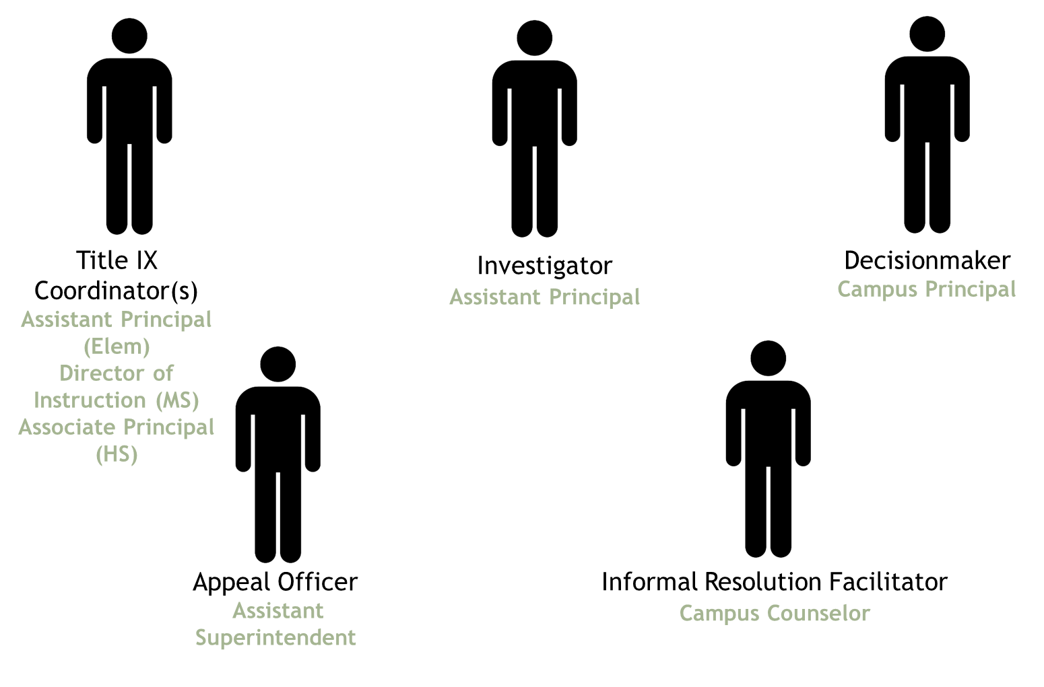
Title IX Personal Assignments in CFISD
Notes:
As previously discussed, the new regulations created various roles for staff members who are tasked with responding to claims of sexual harassment. In CFISD the Campus Title IX Coordinator role will be performed by Assistant Principal at the elementary school level, the Director of Instruction at the middle school level, and the Associate Principal at the high school level.
The Investigator role will be performed by the Assistant Principal. The Decisionmaker role will be performed by the Campus Principal. The Appeal Officer Role will be performed by an Assistant Superintendent. Finally, the Informal Resolution Facilitator role will be performed by a Campus Counselor.

Slide 7
Basic Title IX Process
Campus Title IX Coordinator
Campus Title IX Coordinator
Campus Title IX Coordinator
Knowledge of Allegations of Title IX Sexual Harassment
Title IX Coordinator Reaches out to Complainant
Determination of Supportive Measures
Determination of Emergency Removal
Investigator
Campus Title IX Coordinator
Campus Title IX Coordinator
Investigation
Dismissal Evaluation
Notice of Formal Complaint
Formal Complaint
Written Investigation Report
Parties may Submit Written Questions and Respond to Investigation Report
Written Determination
Appeal
Investigator
Decisionmaker
Decisionmaker
Appeal Officer
Notes:
As detailed by the Title IX Process flowchart, when campus staff gain knowledge of possible allegations of Title IX sexual harassment the Campus Title IX Coordinator must reach out to complainant, make a determination regarding possible supportive measures, and make a determination as to whether an emergency removal is necessary. If a formal complaint is ultimately filed the Campus Title IX Coordinator must provide notice of the formal complaint to the parties. After providing the parties with notice of the complaint the Campus Title IX Coordinator must make a determination as to whether the complaint is subject to dismissal. If the complaint is not dismissed,. The Investigator will then proceed with the investigation and ultimately generate a written report. Next, the Decisionmaker is required to oversee a process where parties may submit questions to each other and submit a response to the investigation report before ultimately issuing a written determination. Finally, the parties may have right to submit an appeal of a complaint dismissal or written determination to the Appeal Officer.

Slide 8
Informal Resolution Requirements
Prior to initiating the informal resolution process both parties must provide voluntary, informed, written consent to the Campus Title IX Coordinator
Campus Title IX Coordinator must provide written notice of the following prior to initiating informal resolution process:
Allegations
Circumstances under which the parties would be precluded from resuming a formal complaint
i.e. after agreeing to a resolution determination
The right to withdraw
Consequences of the process
Conducted by the informal resolution facilitator who assists the parties in reaching an agreement.
A formal complaint must have been filed in order engage in informal resolution
The informal resolution process can be initiated at any time before a final decision is issued.
Not available for allegations involving allegation that an employee sexually harassed a student
The Campus Title IX Coordinator may offer the parties the option to participate in informal resolution but not require their participation
Either party may also request to participate informal resolution by making written request to the Campus Title IX Coordinator
Notes:
If a formal complaint has been filed the Campus Title IX Coordinator may offer the parties the option to participate in the informal resolution process, but not require their participation. The informal resolution process is conducted by the informal resolution facilitator who assists the parties in reaching an agreement and can be initiated at any time before a final decision is issued. However, the informal resolution process is not available for allegations involving an employee sexually harassing a student
Either party may also request to participate in the informal resolution process by making written request to the Campus Title IX Coordinator. Prior to initiating the informal resolution process both parties must provide voluntary written consent to the Campus Title IX Coordinator.
The Campus Title IX Coordinator must provide written notice of the following prior to initiating informal resolution process: the allegations; the circumstances under which the parties would be precluded from resuming a formal complaint; the right to withdraw; and the consequences of the process.

Slide 9
Informal Resolution Requirements
An agreement reached in writing through the informal resolution process cannot be appealed through formal complaint process.
A party may terminate the informal resolution process at any time prior to reaching an informal resolution agreement by contacting the Campus Title IX Coordinator in writing, and the Campus Title IX Coordinator will notify the other party that the informal resolution process has been terminated and resume the formal complaint process.
Notes:
If an agreement is reached in writing through the informal resolution process it may not be appealed through formal complaint process.
A party may terminate the informal resolution process at any time prior to reaching an informal resolution agreement by contacting the Campus Title IX Coordinator in writing, and the Campus Title IX Coordinator will notify the other party that the informal resolution process has been terminated and resume the formal complaint process.

Slide 10
RETALIATION STRICTLY PROHIBITED
New regulations contain an anti-retaliation provision.
Charges of code of conduct violations that arise out of the same facts or circumstances as a report of sex discrimination or sexual harassment for the purpose of interfering with any right under Title IX constitutes retaliation.
Charges for making a materially false statement is not retaliation if charge is not based solely on outcome of the formal complaint process.
Complaints regarding retaliation may be filed in accordance with the District’s Title IX formal complaint process.
Notes:
Retaliation is expressly prohibited under the regulations. No school or person may intimidate, threaten, coerce, or discriminate against any individual for the purpose of interfering with any right or privilege secured by Title IX, or because the individual has made a report or complaint, testified, assisted, or participated or refused to participate in any manner in a Title IX investigation or proceeding. Further, charging a student with code of conduct violations that arise out of the same facts or circumstances as a report or formal complaint of sexual harassment for the purpose of interfering with any right or privilege secured by Title IX constitutes retaliation.
Complaints alleging retaliation may be filed according to a District’s Title IX formal complaint process.

Slide 11
Record Keeping
Must maintain for a period of seven years records of—
Final determination
Any audio or audiovisual recording or transcript
Any disciplinary sanctions imposed on the respondent
Any remedies provided to the complainant designed to restore or preserve equal access to the recipient's education program or activity;
Any supportive measures taken or the reason for no supportive measures
Any appeal and the result
Any informal resolution and the result; and
All materials used to train Title IX Personnel
Must document the basis for conclusions reflecting that the district’s response was not deliberately indifferent
Must document measures designed and taken to restore or preserve equal access to the recipient's education program or activity.
.
Notes:
Pursuant to the regulations, the District is required to maintain records of the final determination, any audio or audiovisual recording or transcript, any disciplinary sanctions imposed on the respondent, any remedies provided to the complainant, any supportive measures taken or the reason for no supportive measures, any appeal and the result therefrom, any informal resolution and the result therefrom, and all materials used to train Title IX Personnel for a period of seven years.
Further, the District is required to document the basis for its conclusion reflecting that its response was not deliberately indifferent, and document that it has taken measures designed to restore or preserve equal access to the District’s education program or activity.

Slide 12
THANK YOU!

