Slide 1
The When, What, and How of Initially Handling Potential Title IX Sexual Harassment Claims
Harry Wright, Jr. , Assistant General Counsel
Elementary AP Meeting

Slide 2
When?

Slide 3
Schools Response Obligations
A school must respond when it has:
Actual knowledge
Of sexual harassment
That occurred within the school’s education program or activity
Against a person in the US
A school has actual knowledge when:
ANY employee of an elementary or secondary school has notice of sexual harassment or allegations of sexual harassment
Includes teachers, teacher’s aide, bus drivers, cafeteria workers, counselors, school resource officers, maintenance staff worker, etc.
A school’s education programs or activities include any events, or circumstances over which the school exercised substantial control over both
the respondent; and
the context in which the sexual harassment occurs

Slide 4
What constitutes sexual harassment under Title IX?
“Sexual harassment” means conduct on the basis of sex that satisfies one or more of the following:
Quid Pro Quo: a school employee conditioning education benefits on participation in unwelcome sexual conduct
Hostile Environment: Unwelcome conduct that a reasonable person would determine is so severe, pervasive, and objectively offensive that it effectively denies a person equal access to the school’s education program or activity
“Sexual assault” as defined in 20 U.S.C. 1092(f)(6)(A)(v), “dating violence” as defined in 34 U.S.C. 12291(a)(10), “domestic violence” as defined in 34 U.S.C. 12291(a)(8), or “stalking” as defined in 34 U.S.C. 12291(a)(30).

Slide 5
What constitutes sexual harassment under Title IX?
The definition of sexual assault under Title IX includes:
non-consensual sexual penetration (vaginal, anal, or oral, including with an object);
sexual conduct where the victim is incapable of giving consent because of age or temporary or permanent mental or physical incapacity;
fondling (non-consensual touching of private body parts above or under clothing for sexual gratification);
incest (nonforcible sexual intercourse between persons who are related to each other within the degrees wherein marriage is prohibited by law);
and statutory rape (nonforcible sexual intercourse with a person who is under the statutory age of consent)

Slide 6
What constitutes sexual harassment under Title IX?
The term "dating violence" means violence committed by a person-
(A) who is or has been in a social relationship of a romantic or intimate nature with the victim; and
(B) where the existence of such a relationship shall be determined based on a consideration of the following factors:
(i) The length of the relationship.
(ii) The type of relationship.
(iii) The frequency of interaction between the persons involved in the relationship.

Slide 7
What constitutes sexual harassment under Title IX?
Domestic Violence includes Felony or misdemeanor crimes of violence committed by:
(1) a current or former spouse or intimate partner of the victim;
(2) a person with whom the victim shares a child in common;
(3) a person who is cohabitating with or has cohabitated with the victim as a spouse or intimate partner;
(4) a person similarly situated to a spouse of the victim under the domestic or family violence laws of the state; or
(5) any other person against an adult or youth victim who is protected from that person’s acts under the domestic or family violence laws of the state

Slide 8
What constitutes sexual harassment under Title IX?
The term "stalking" means engaging in a course of conduct directed at a specific person that would cause a reasonable person to-
(A) fear for his or her safety or the safety of others; or
(B) suffer substantial emotional distress.

Slide 9
What is my role?

Slide 10
Title IX Assignments in CFISD
Title IX Coordinator(s)
Assistant Principal (Elem)
Director of Instruction
(MS)
Associate Principal (HS)
Investigator
Assistant Principal
Decision maker
Campus Principal
Appeal Officer
Assistant Superintendent
Informal Resolution Facilitator
Campus Counselor

Slide 11
Basic Title IX Process
Deputy Title IX Coordinator
Deputy Title IX Coordinator
Deputy Title IX Coordinator
Knowledge of Inappropriate Conduct that is Sexual in Nature
Title IX Coordinator Reaches out to Complainant
Determination of Supportive Measures
Determination of Emergency Removal
Investigator
Deputy Title IX Coordinator
Deputy Title IX Coordinator
Investigation
Dismissal Evaluation
Notice of Formal Complaint
Formal Complaint
Written Investigation Report
Parties may Submit Written Questions and Respond to Investigation Report
Written Determination
Appeal
Investigator
Decision Maker
Decision Maker
Appeal Officer

Slide 12
How?

Slide 13
Title IX Guidance
The District’s Title IX Guidance documents and forms can be found on the District’s intranet page can be assessed as follows:
First, assess the District’s webpage.
Next, go to the staff section and select intranet.
Next, click on the DLT login in the top right-hand corner.
Next, select School Leadership Hub
Next, select Title IX
https://www.cfisd.net/
Contact Student Services if any questions or need help.

Slide 14
Initial Response to Allegations of Sexual Harassment
Upon receiving any report of misconduct involving sex, gender or gender identity, or sexual orientation campus administration should:
1.) Immediately notify the Campus and/or District Title IX Coordinator; and
2.) Complete the Sexual Misconduct Report Intake Form (See Document 1) and forward it to the Campus Title IX Coordinator.
Upon receipt of a report of unwelcome sex-based misconduct, the Title IX Coordinator must determine whether the conduct, if proved, implicates Title IX.

Slide 15
Initial Response to Allegations of Sexual Harassment—Document 1 https://inside.cfisd.net/download_file/5985/1285

Slide 16
Initial Response to Allegations of Sexual Harassment
Until the Title IX Coordinator or Campus Title IX Coordinator decides if Title IX applies:
Do not conduct investigation interviews (asking for or collecting evidence)—only conduct intake meetings with the reporting party and the complainant/family. An intake meeting means asking what is alleged to have happened, not asking for evidence to support the allegations.
Do not discipline either party, including the alleged perpetrator. Contact the Title IX Coordinator to authorize suspensions or other removals from school or activities.
Do not violate the confidentiality of the alleged victim by telling the alleged perpetrator the alleged victim’s name or that a report has been made. We cannot share such information until the Title IX Coordinator or the Campus Title IX Coordinator says Title IX is not implicated, a Title IX formal complaint is filed, or the alleged victim and their parent(s)/guardian(s) allow it.

Slide 17
Initial Response to Allegations of Sexual Harassment
If the alleged conduct, even if proved, would not be Title IX “sexual harassment”, campus staff may proceed with disciplining the student in accordance with the Code of Conduct.
If the alleged conduct does constitute Title IX sexual harassment, a school only impose punitive or disciplinary consequences against the alleged perpetrator by going through the formal Title IX Complaint process.
If the alleged victim decides not file a Title IX complaint, the Campus Title IX Coordinator may still elect to file a complaint.

Slide 18
Interim Options to Address Conduct: Supportive Measures
While you may not immediately discipline a student if the alleged conduct constitutes sexual harassment under Title IX, you have several options to address the conduct.
If a parent or student makes allegations that could amount to sexual harassment, the campus Title IX Coordinator is required to offer supportive measures
Examples of supportive measures include:
Counseling
Course related adjustments
Modifications of work or class schedules
Campus escort services
Leaves of absence
Increased security and monitoring of certain areas of campus, and
Mutual restrictions on contact between the parties

Slide 19
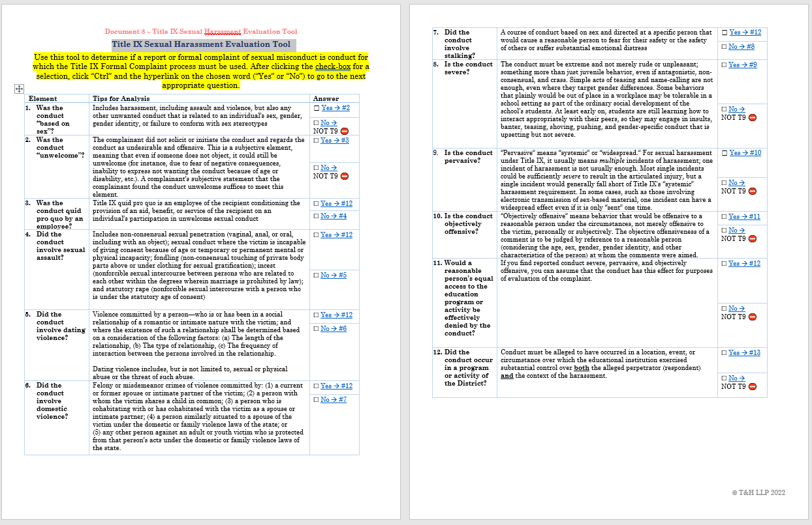
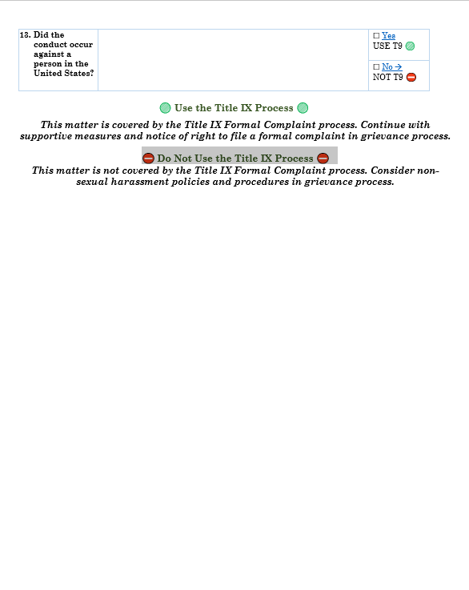
Determining whether Allegations Constitute Title IX Sexual Harassment—Document 8
https://inside.cfisd.net/download_file/5992/1285

Slide 20
What constitutes sexual harassment under Title IX?
Scenario No. 1:
As she was leaving her math class Tara ask Jim, a fellow student, if he could help her with an homework assignment after school. Jim responded by saying he would only help her if she let him she her breasts?
Could this be sexual harassment under Title IX?
Answer: No. First, this is not quid pro qou sexual harassment because it does not involve school employee conditioning education benefits on participation in unwelcomed sexual conduct. Second, Jim’s one comment by itself was not sufficiently severe and pervasive enough to create a hostile environment.

Slide 21
What constitutes sexual harassment under Title IX?
Scenario No. 2:
A parent reports that her first grade son Mike reported that William, another student pinched his but during recess. When Mike was asked to describe what happened he stated that they were just playing around and that it only happened once. William also communicated the same.
Could this be sexual harassment under Title IX?
Answer: No. While it is alleged that the a student was touched inappropriately, the circumstances indicate that it was not done for sexual gratification so it would not meet the definition of fondling.

Slide 22
What constitutes sexual harassment under Title IX?
Scenario No. 3:
Will repeatedly makes jokes and denigrating comments about Chris’ gender expression. He makes these joke in Chris’ presence while on the bus and in class.
Could this be sexual harassment under Title IX?
Answer: Yes. Will’s comments are sex based and they are so severe, pervasive, and objectively offensive that they could constitute hostile environment harassment.

Slide 23
What constitutes sexual harassment under Title IX?
Scenario No. 4:
Susan has alleged that while she was walking down the hall Arthur pushed John and as John fell forward his outstretched hand touched her buttocks. She goes on to state how the incident made her very uncomfortable and upset her.
Could this be sexual harassment under Title IX?
Answer: No. While the contact was inappropriate, it was not done for sexual gratification.

Slide 24
What constitutes sexual harassment under Title IX?
Scenario No. 5:
Tiffany and Sam are fifth graders who both agreed to go into a restroom at school to make out. Tiffany reported that while they were making out Sam touched her breast and that she pushed his hand away telling him no. The continued kissing and a minute later Sam placed his hand inside in shirt touching her breast. In response to Tiffany proceeded to leave the restroom.
Could this be sexual harassment under Title IX?
Answer: Yes. This conduct could be considered fondling because it involved nonconsensual touching of private body parts.

Slide 25
What constitutes sexual harassment under Title IX?
Scenario No. 6:
Monica and Burt were in a relationship until Monica decided that she wanted to end things. Since breaking up, Burt sends Monica at least twenty texts during each school day wanting to talk about their relationship. Additionally, he often follows her when she is walking in the hall at school and he also shows up any extracurricular event she takes part in. In response to these actions Monica has communicated to school staff that she is afraid of Burt.
Could this be sexual harassment under Title IX?
Answer: Yes. Burt’s conduct could constitute "stalking" because he has engaged in conduct directed at a specific person that would cause a reasonable person to fear for his or her safety or suffer substantial emotional distress.

Slide 26
What constitutes sexual harassment under Title IX?
Scenario No. 7:
Wendy and Steve are seventh graders who have been dating for two years. Wendy slaps Steve in the face after she observes Steve holding hands with another female student on campus.
Could this be sexual harassment under Title IX?
Answer: Yes. This conduct could be considered dating violence.

